Slide 1
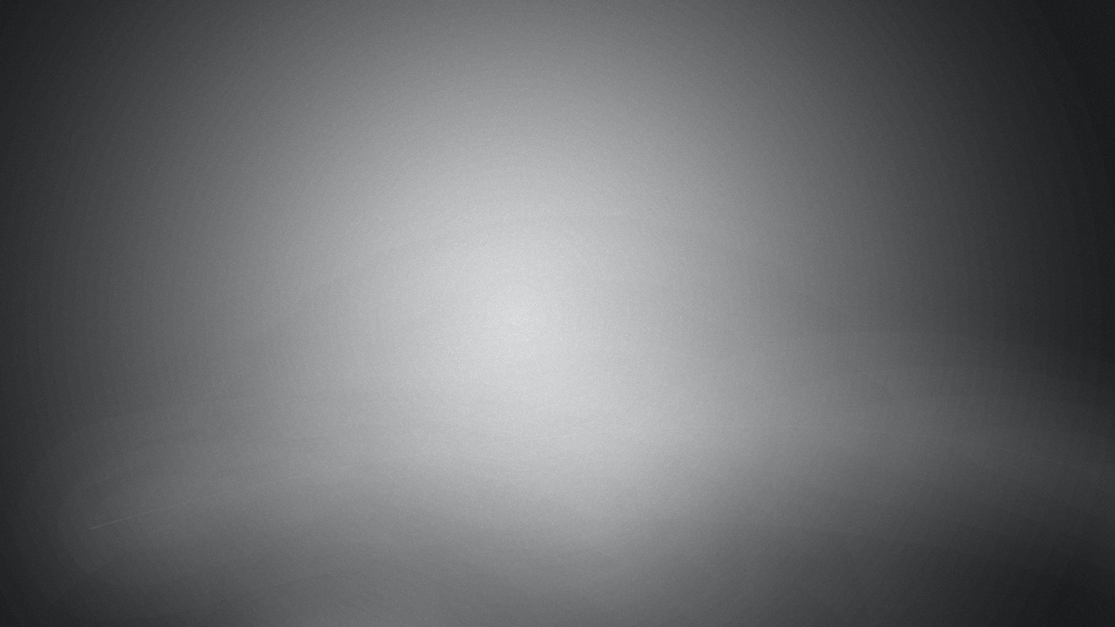
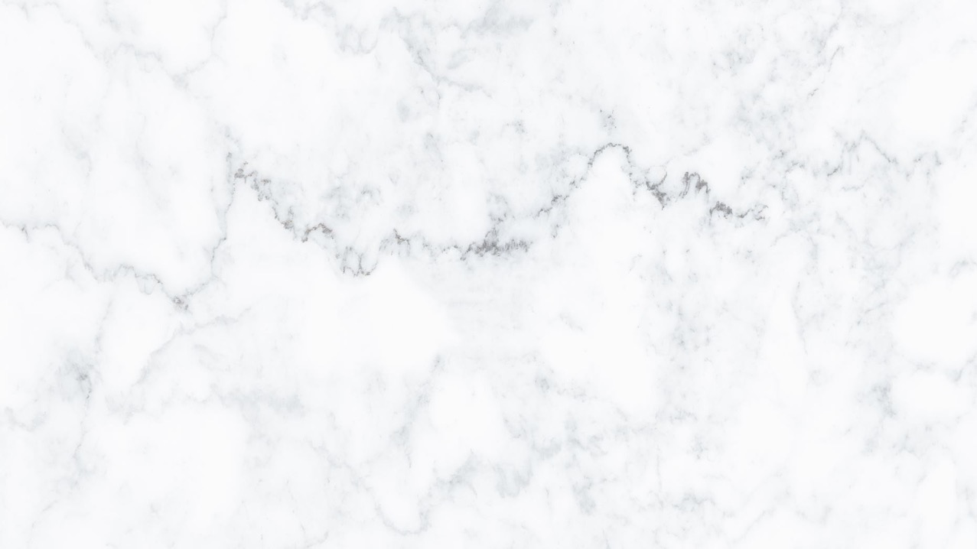
3D Graphics
Workshop 14 – Coursera week 17

Slide 2
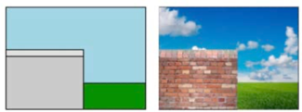
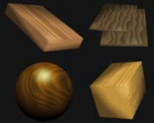
Texture
Texturing can be divided into two categories:
texture mapping (also called image mapping ) and
procedural texturing
Both add realistic details to 3D models without increasing the number of polygons
Texture mapping
Places images on top of the polygons and thus can make simple models look incredibly realistic and is the easiest way to add fine detail.
Procedural textures
Calculated mathematically to provide realism at any resolution

Slide 3
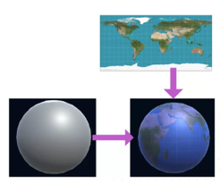
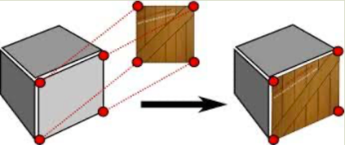
Texture mapping
Texture mapping uses an image map ,
mage Map
literally just an image
a 2D array of intensities.
Any image may be used as the source for the image map.
These images are ‘painted’ onto polygons – like taking some gift-wrap and sticking it onto the polygons.

Slide 4
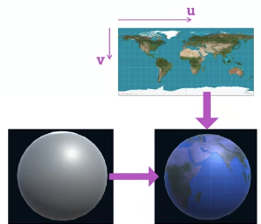
Texture mapping
Texture coordinate on Image Map
Convention is to use u and v instead of x and y
Scale to (0,0) as the top left and (1,1) as the bottom right.

Slide 5
Texture mapping
Mapping Image Map to a fragment
Need to know the UV coordinate of each fragment.
Each vertex has a UV coordinate created in a model
Done in graphics tool like Maya or Blender
In shader
Interpolate the UV values for each Vertex across the polygon to get the UV values for each fragment.

Slide 6
Lab
Work on Workshop 14 Lab 1.
In this activity, we are going to
implement a simple Texture Shader and Texture Light Shader.

Slide 7
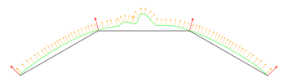
Normal Map
To make a smooth surface “bumping” we can change the actual vertex position.
However, this can be computation expensive
Another way to to use Normal map
The idea is to modify the normal, in turn will modify the lighting value.
This gives the illusion that surface is “bumping”

Slide 8
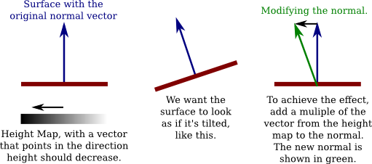
Normal Map

Slide 9
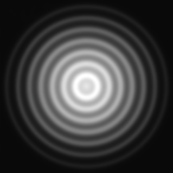
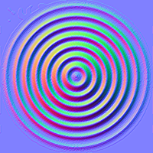
Normal Map
A texture can comes with a normal map.
The normal map shader then uses the normal map information to modify the normal of the vertex which in turn affect the value of the lighting.
Normal map is usually generated by the 3D illustrator using external software.

Slide 10
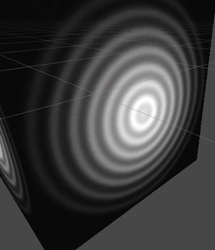
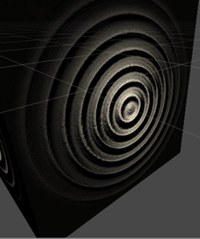
Normal Map
Comparing the effect
Texture map only
Texture map with normal map

Slide 11
Normal Map
How is the value stored in Normal Map?
Each pixel in the texture map will have a corresponding pixel in the normal map.
Each pixel in the normal map is a value of the modified “normal”.
Each RGB value corresponding to the xyz value of the modified “normal”.

Slide 12
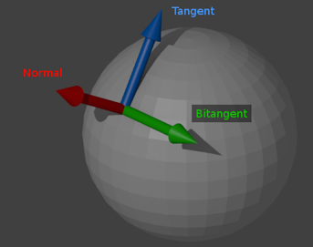
Normal Map
The Normal map normal/pixel value is stored in ”object space”.
We need to transform the above value from “object space” to “world space” so that it can be used to calculate the new light value.
In order to perform the conversion, for each vertex we need to know:
Normal vector
The “up” perpendicular to surface.
Tangent vector
Parallel to the surface and perpendicular to normal.
Bitangent (Bi-normal) vector
Perpendicular to Normal and Tangent.

Slide 13

Normal Map
Form the normal in world space using
Normal vector in world space
Tangent vector in world space
Bitangent (Bi-normal) vector in world space
Normal Map RBG value in object space
Normal Map RBG value in object space
New normal in world space

Slide 14
Lab
Work on Workshop 14 Lab 2.
In this activity, we are going to
implement a simple Normal Map Shader.

